Slide 1
Life Insurance Policy
“ZINDAGI KE SAAT BHI ZINDAGI KE BAAD BHI”

Slide 2
What is Life Insurance
Life insurance is a contract between you and an insurance company. You pay regular premiums, and in return, the insurer agrees to pay a sum of money (called the death benefit) to the beneficiaries you choose if you die while the policy is in force.

Slide 3
ABSTRACT
Life Insurance Policy Management System is a database management project designed to automate and simplify the management of life insurance operations using SQL. The system provides a centralized platform for storing and managing information related to policyholders, insurance policies, agents, beneficiaries, premium payments, claims, and policy renewals. It eliminates the need for manual record-keeping, improves data accuracy, and enables faster access to information.

Slide 4
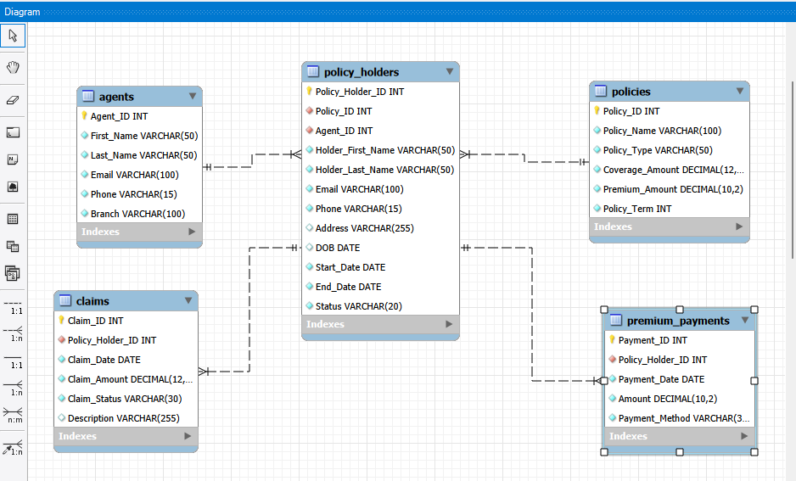
ER - Diagram

Slide 5
STRUCTURE OF TABLE
TABLES
1.Policies Table
2.Agents Table
3. Policy Holders Table
4. Premium Payment
Table
5. Claim Table

Slide 6
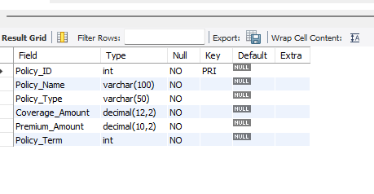
STRUCTURE OF POLICIES TABLE
Policies Table
This table stores details of all insurance policies, including the policy name, type, coverage amount, premium amount, and policy term
SYNTAX
Desc Policies;

Slide 7
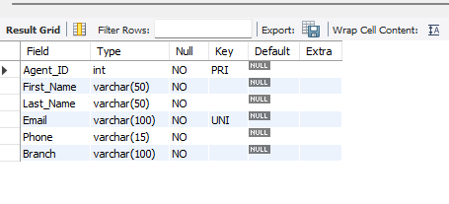
STRUCTURE OF AGENTS TABLE
Agents Table
This table maintains the professional details of insurance agents, including their identity, contact information, and branch affiliation
SYNTAX
Desc Agents;

Slide 8
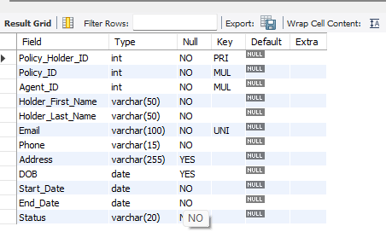
STRUCTURE OF POLICY HOLDERS TABLE
Policy Holders Table
This table stores the personal and policy details of insurance customers. It links each policy holder to a specific policy and agent for easy record management
SYNTAX
Desc Policy_Holders;

Slide 9
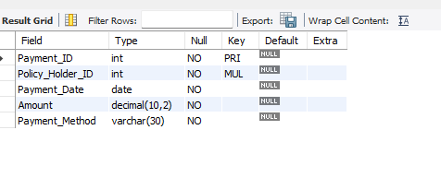
STRUCTURE OF PREMIUM PAYMENT TABLE
Premium Payment table
This table records all premium payments made by policy holders. It stores the payment date, amount, and payment method for tracking payment history
SYNTAX
Desc Premium_Payments;

Slide 10
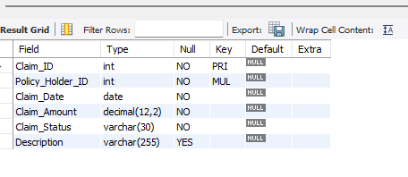
STRUCTURE OF CLAIM TABLE
Claim Table
This table maintains records of insurance claims submitted by policy holders. It tracks claim details, status, and amount to ensure efficient claim processing and management
SYNTAX
Desc Claims;

Slide 11
CONTENTS OF TABLES
TABLES
Policies Table
Agents Table
Policy Holders Table
Premium Payment Table
Claim Table

Slide 12
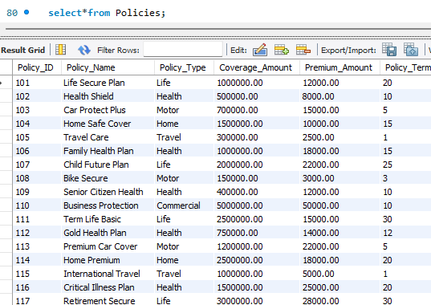
CONTENTS OF POLICIES TABLE
Policies Table
This table stores details of all insurance policies, including the policy name, type, coverage amount, premium amount, and policy term
SYNTAX
Select*from Policies;

Slide 13
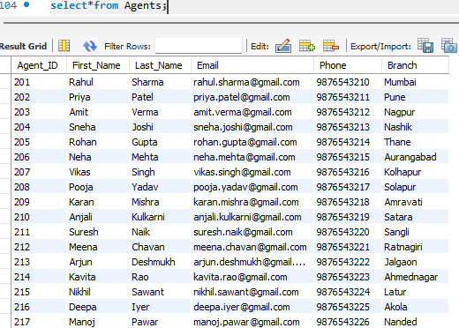
CONTENTS OF AGENTS TABLEE
Agents Table
This table maintains the professional details of insurance agents, including their identity, contact information, and branch affiliation
SYNTAX
select*from Agents;

Slide 14
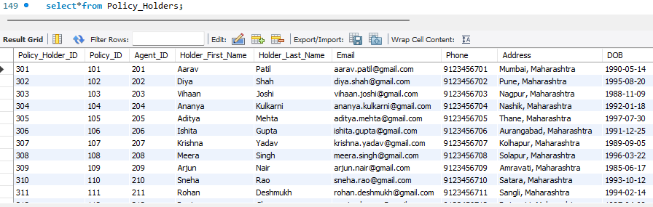
CONTENTS OF POLICY HOLDERS TABLE
Policy Holders Table
This table stores the personal and policy details of insurance customers. It links each policy holder to a specific policy and agent for easy record management
SYNTAX
select*from Policy_Holders;

Slide 15
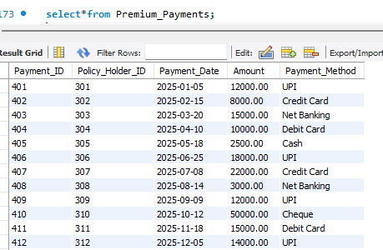
CONTENTS OF PRRMIUM PAYMENT TABLE
Premium Payment Table
This table records all premium payments made by policy holders. It stores the payment date, amount, and payment method for tracking payment history
SYNTAX
select*from Premium_Payments;

Slide 16
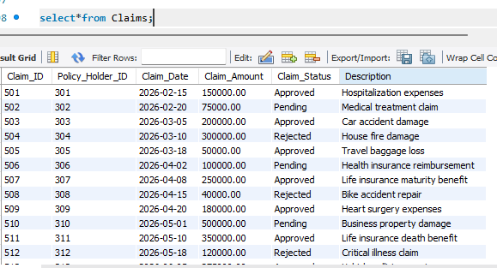
CONTENTS OF CLAIM TABLES
Claim Table
This table maintains records of insurance claims submitted by policy holders. It tracks claim details, status, and amount to ensure efficient claim processing and management
SYNTAX
select*from Claims;

Slide 17
SUB-QUERY
NESTED SELECT STATEMENTS FOR DEEPER ANALYIS

Slide 18
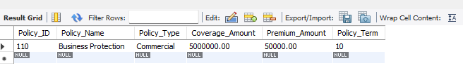
SUB-QUERY
1. Find the policy with the highest premium amount
SYNTAX
SELECT *FROM Policies WHERE Premium_Amount = ( SELECT MAX(Premium_Amount) FROM Policies);

Slide 19
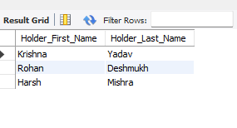
SUB-QUERY
2 . find policy holder whose policy term is more than 20 year
SYNTAX
SELECT Holder_First_Name, Holder_Last_Name FROM Policy_Holders WHERE Policy_ID IN ( SELECT Policy_ID FROM Policies WHERE Policy_Term > 20);

Slide 20
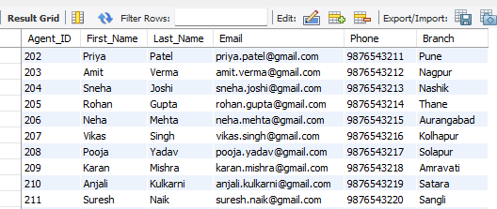
SUB-QUERY
3 . find agents who mange active policy holders
SYNTAX
SELECT *FROM Agents WHERE Agent_ID IN ( SELECT Agent_ID FROM Policy_Holders WHERE Status = 'Active');

Slide 21
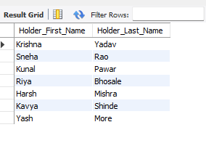
SUB-QUERY
4 . find policy holders who have made a payment above 20000
SYNTAX
SELECT Holder_First_Name, Holder_Last_Name FROM Policy_Holders WHERE Policy_Holder_ID IN ( SELECT Policy_Holder_ID FROM Premium_Payments WHERE Amount > 20000);

Slide 22
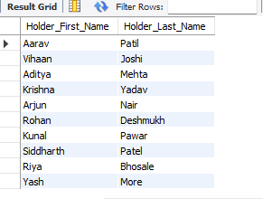
SUB-QUERY
5 . find policy holders who have an Approved claim
SELECT Holder_First_Name, Holder_Last_Name FROM Policy_Holders WHERE Policy_Holder_ID IN ( SELECT Policy_Holder_ID FROM Claims WHERE Claim_Status = 'Approved');

Slide 23
JOINS
INNER,LEFT AND RIGHT JOIN ACROSS THE TABLE

Slide 24
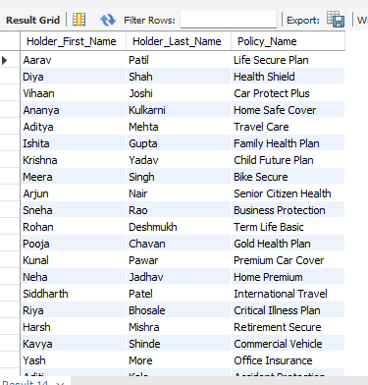
JOINS
1 . Show the Policy Holder Name and Policy Name
SYNTAX
SELECT ph.Holder_First_Name, ph.Holder_Last_Name, p.Policy_Name FROM Policy_Holders phINNER JOIN Policies pON ph.Policy_ID = p.Policy_ID;

Slide 25
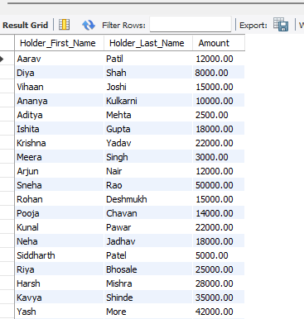
JOINS
2. Show all Policy Holders and their Payment Amount
SYNTAX
SELECT ph.Holder_First_Name, ph.Holder_Last_Name, pp.AmountFROM Policy_Holders phLEFT JOIN Premium_Payments ppON ph.Policy_Holder_ID = pp.Policy_Holder_ID;

Slide 26
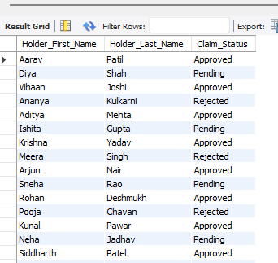
JOINS
3 . Show all Policy Holders and their Claim Status
SYNTAX
SELECT ph.Holder_First_Name, ph.Holder_Last_Name, c.Claim_StatusFROM Policy_Holders phLEFT JOIN Claims cON ph.Policy_Holder_ID = c.Policy_Holder_ID;

Slide 27
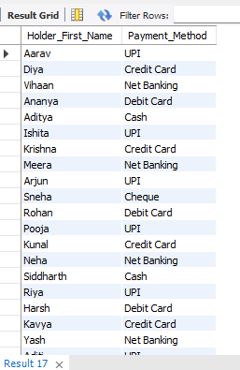
JOINS
4 . Show all Policy Holders and their Payment Method
SYNTAX
SELECT ph.Holder_First_Name, pp.Payment_MethodFROM Policy_Holders phLEFT JOIN Premium_Payments ppON ph.Policy_Holder_ID = pp.Policy_Holder_ID;

Slide 28
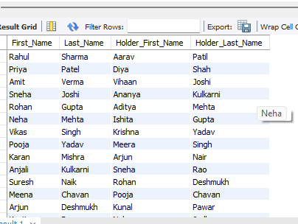
JOINS
5 . Display all agents and the policy holders assigned to them
SYNTAX
SELECT a.First_Name, a.Last_Name, ph.Holder_First_Name, ph.Holder_Last_NameFROM Policy_Holders phRIGHT JOIN Agents aON ph.Agent_ID = a.Agent_ID;

Slide 29
WINDOW FUNCTIONS
RANKING,RUNNIG TOTALS,AND ROW-RELATIVE ANALYSIS

Slide 30
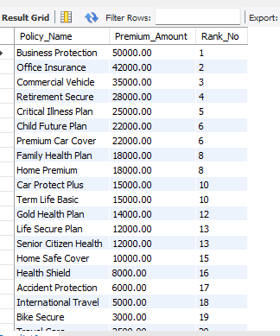
WINDOW FUNCTIONS
1 . Rank policies based on Premium Amount
SYNTAX
SELECT Policy_Name, Premium_Amount, RANK() OVER(ORDER BY Premium_Amount DESC) AS Rank_NoFROM Policies;

Slide 31
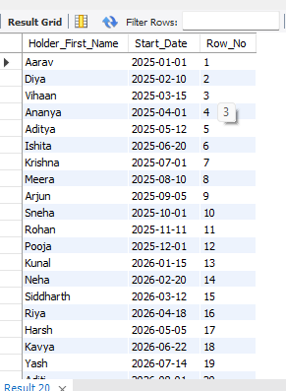
WINDOW FUNCTION
2 . Display the policy holder name with a row number based on the Start Date
SYNTAX
SELECT Holder_First_Name, Start_Date, ROW_NUMBER() OVER(ORDER BY Start_Date) AS Row_NoFROM Policy_Holders;

Slide 32
VIEWS
SAVED QUERY FOR REUSABLE,PRE-AGGREGATED RESULTS

Slide 33
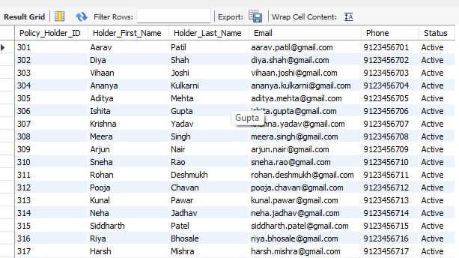
VIEWS
1 . Create a view to show all policy holder details
SYNTXA
CREATE VIEW vw_Policy_Holders ASSELECT Policy_Holder_ID, Holder_First_Name, Holder_Last_Name, Email, Phone, StatusFROM Policy_Holders;select* from vw_Policy_Holders;

Slide 34
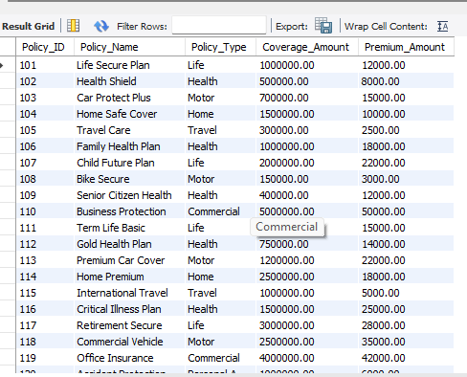
VIEWS
2 . Create a view to show policy details
SYNTAX
CREATE VIEW vw_Policies ASSELECT Policy_ID, Policy_Name, Policy_Type, Coverage_Amount, Premium_AmountFROM Policies;select*from vw_Policies;

Slide 35
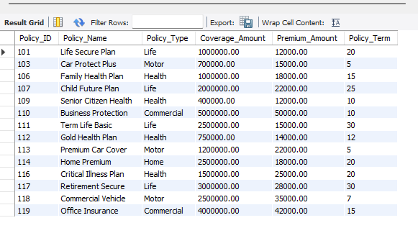
VIEWS
3 . Create a view showing policies with premium amount greater than 10000
SYNTAX
CREATE VIEW Expensive_Policies ASSELECT *FROM PoliciesWHERE Premium_Amount>10000;select*from Expensive_Policies;

Slide 36
PREPARED BY :
Prathamesh Jaiswal
ITvedant-Data Science& Analytics with Artificial Intalligence
MAY26-T380
Life Insurance Policy Management System

Slide 37
THANK YOU

